Slide 1
Jabil FS2 Vendor Portal
Suppliers User Manuals
Version 1.3
Notes:
Add version

Slide 2




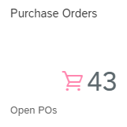
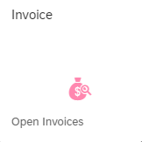
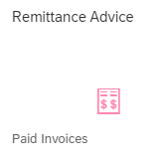
User Account Activation
Receive an email invitation link
Set up your password
If you did not receive the email invitation link, please submit Jabil FS2 Vendor Portal - Queries Form
1
FS2 VENDOR PORTAL
A platform for suppliers to ease and simplify the business process with Jabil
Invoice Submission
Click on the "Purchase Orders" tile
Use the search box to enter your PO number. Select the relevant line item, and then click on "Copy to Invoice“
Enter the necessary invoice details, and click on "Submit"
The benefits this platform has to offer includes: ​
Gain access to enter invoice info directly online in Vendor Portal (self-flip) - a much faster and accurate way to submit your invoices for payment
Search, retrieve and flip Purchase Orders (self-flip PO into invoices and view the status of invoices with a click
Instant access to PO, Invoice and Payment information in one place
Check Invoice/ Payment status online at any time
And most importantly, the service is Free of Charge!
2
3
Invoice Status Checking
Click on the "Invoice" tile
View the status of all your invoices displayed here
4
Payment Remittance Advice
Click on the "Remittance Advice" tile
Retrieve your payment advice here

Slide 3

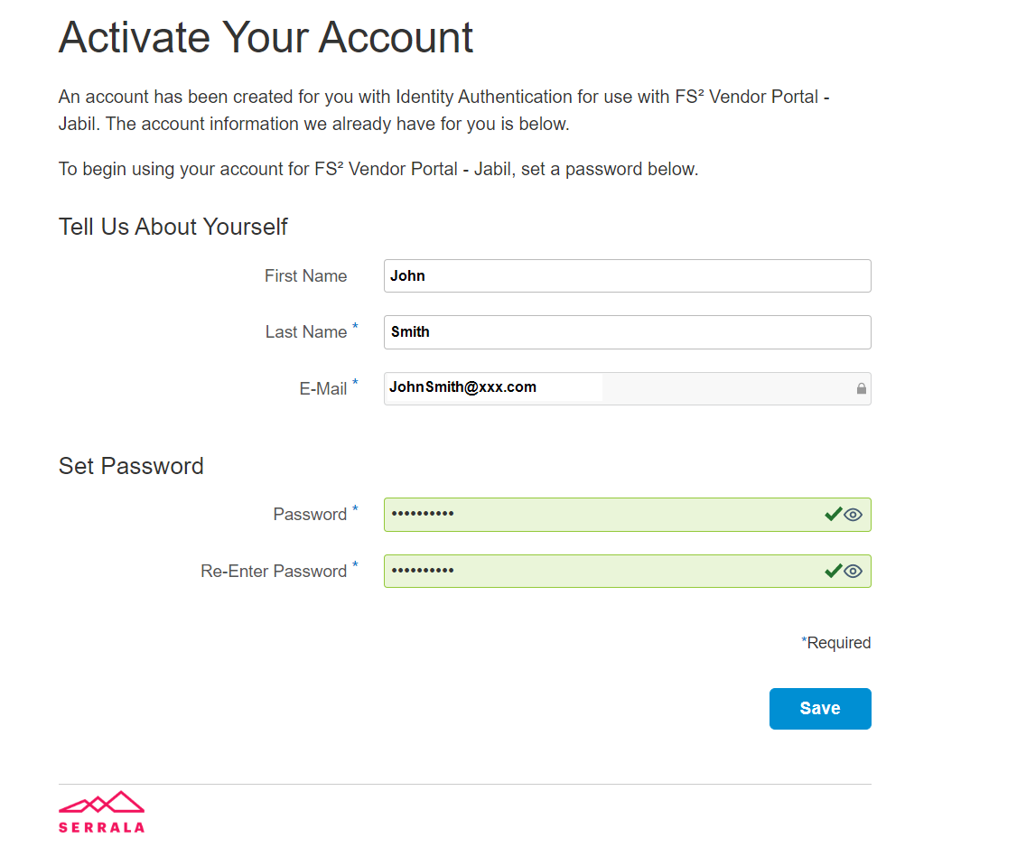
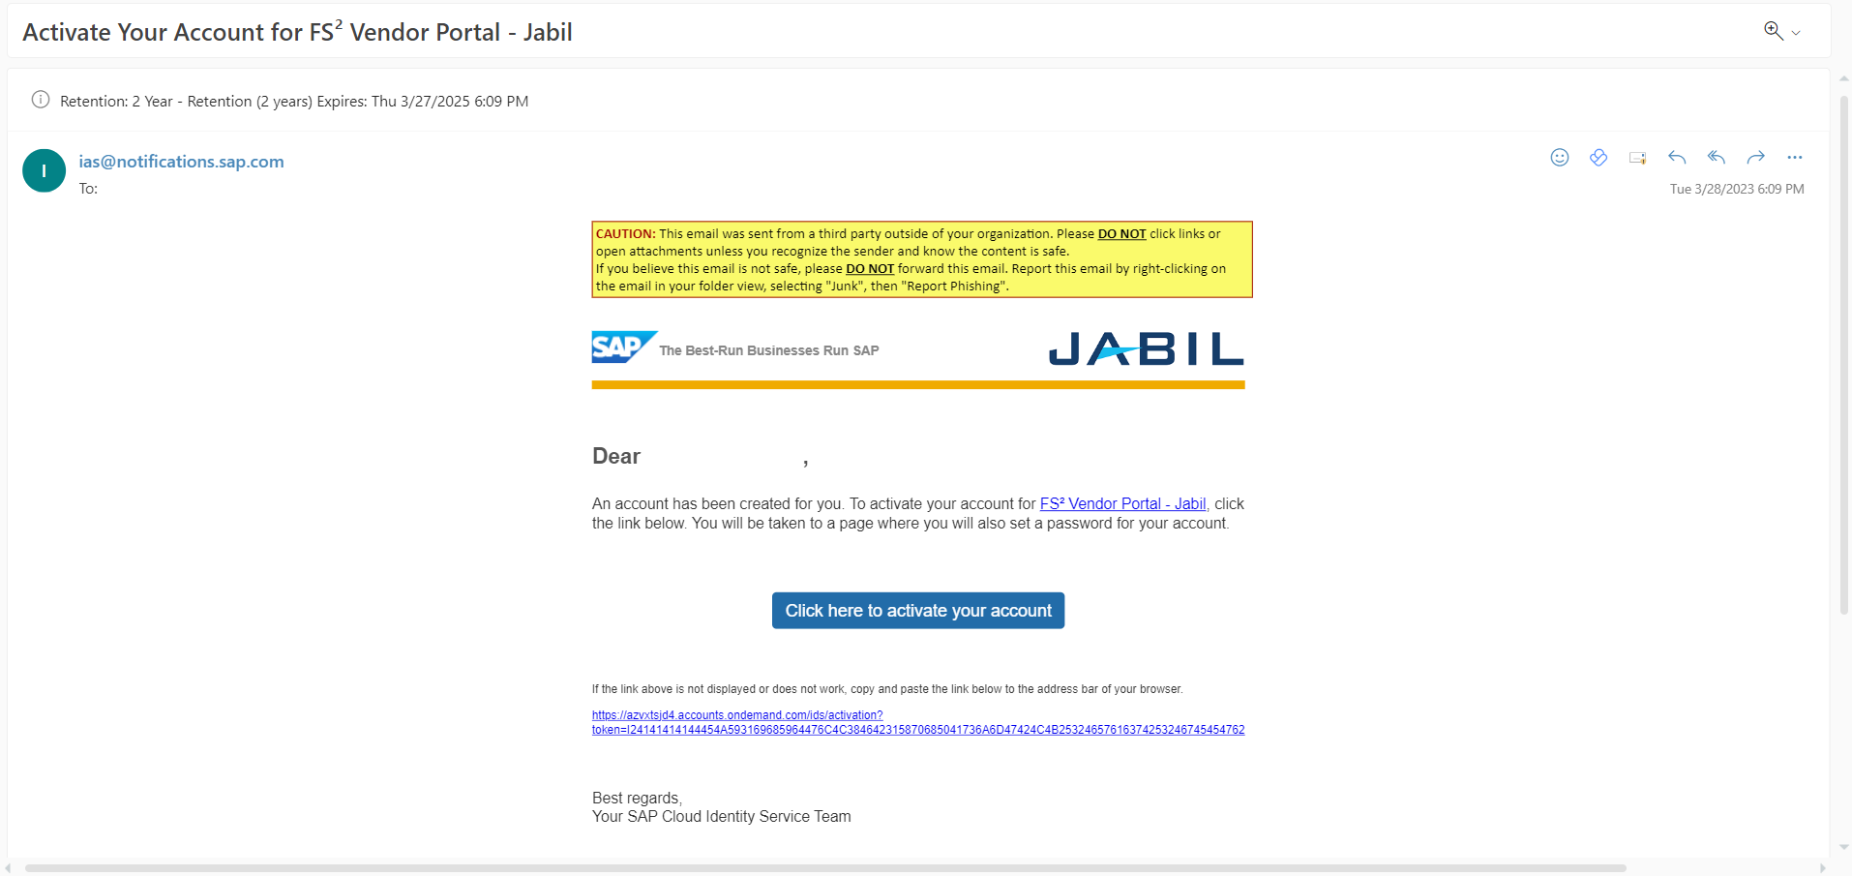

1. User Account Activation
Email Invitation Link from ias@notifications.sap.com
You will be directed to Vendor Portal Account Activation page
Ensure your details is correct
Set your own password, then click “Save”
Things to take note:
Each account registration link can only be activated once If you are not the right person to access to Vendor Portal, please log a ticket using the Jabil FS2 Vendor Portal - Queries Form Shared mailbox required for Vendor Portal registration if more than two users need access (Note: A distribution list is not feasible and not acceptable)
Click the blue box to activate your Vendor Portal user account
If you do not receive any Vendor Portal invitation link from us, please log a ticket through
Jabil FS2 Vendor Portal - Queries Form

Slide 4
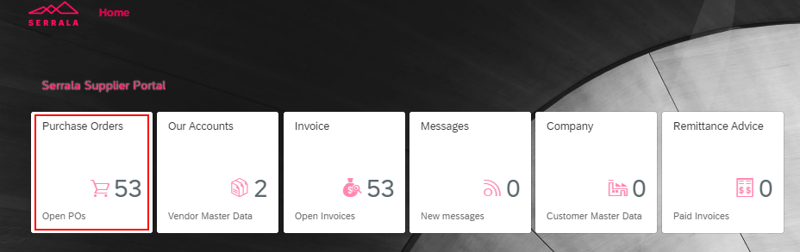
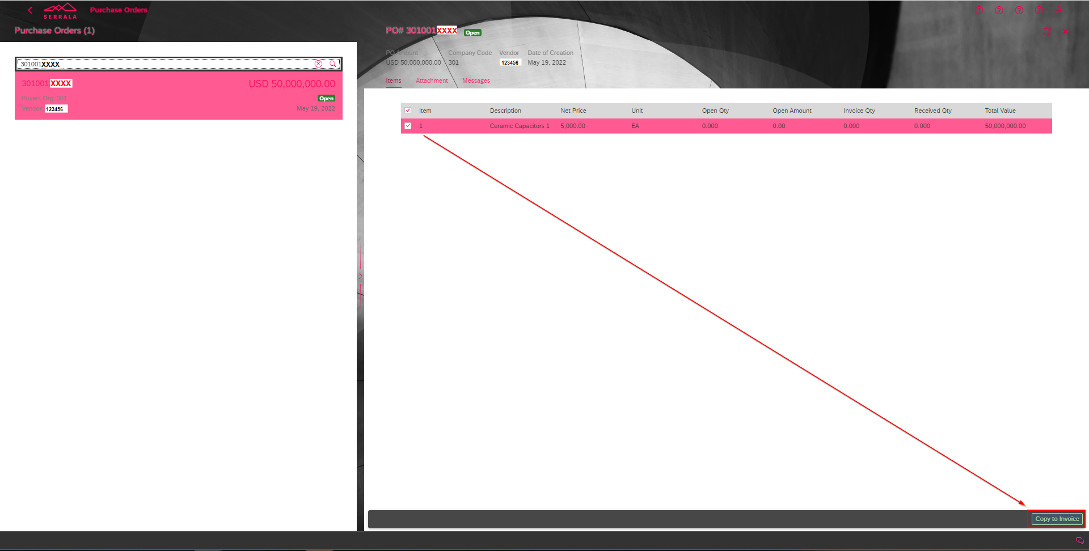
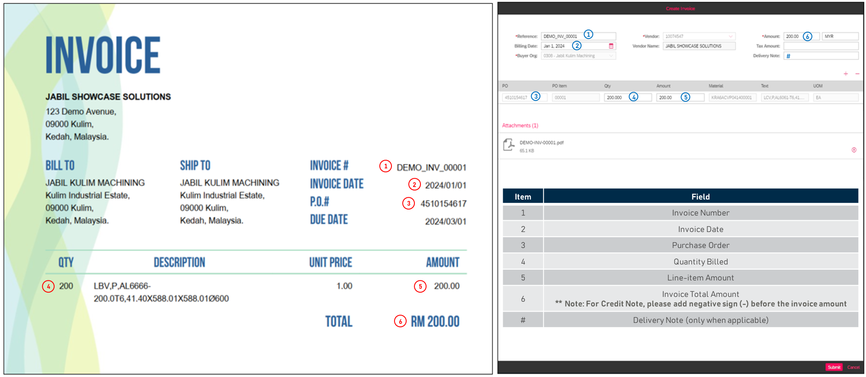

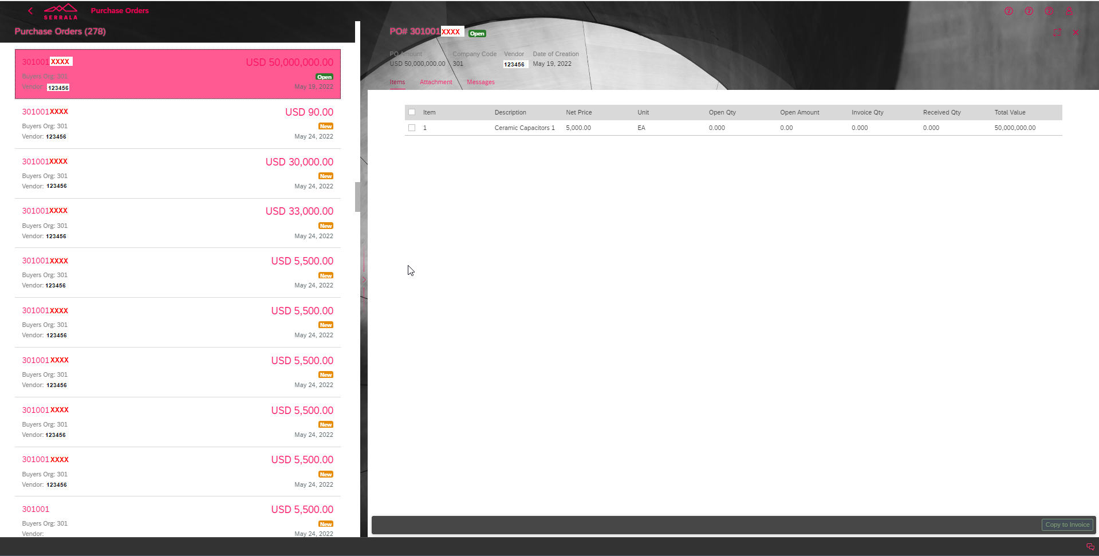
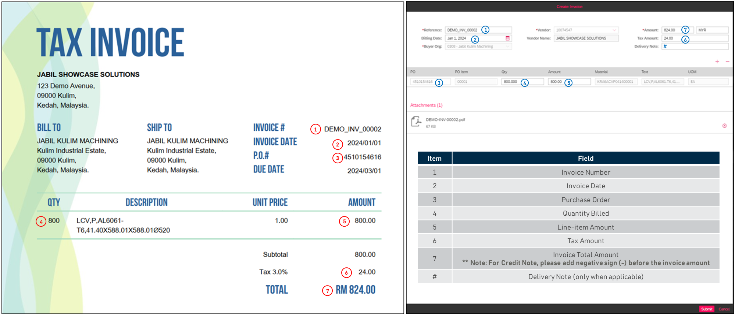
2. Invoice Submission
- “PURCHASE ORDERS” tile
To submit an invoice, key in the Purchase Order you wish to invoice against, then click to select it
Select the line item to be billed and click “Copy to Invoice”
Click on the "Purchase Orders" tile
This tile displays the open Purchase Orders with suppliers, at the same time enabling invoice submission directly from the purchase order
STEP
1
STEP
2
STEP
3
Invoice without Tax
Invoice with Tax
Available Purchase Orders are displayed on the left side panel of the screen
Feel free to submit an invoice as long as the corresponding PO is shown here, regardless of the wording
When a purchase order is selected, the details will appear on the right side
Note
The following PO cannot be located:
PO deleted or blocked:
Please contact the buyer to unblock it
PO created over one year:
Please reach out to PIC accountant

Slide 5
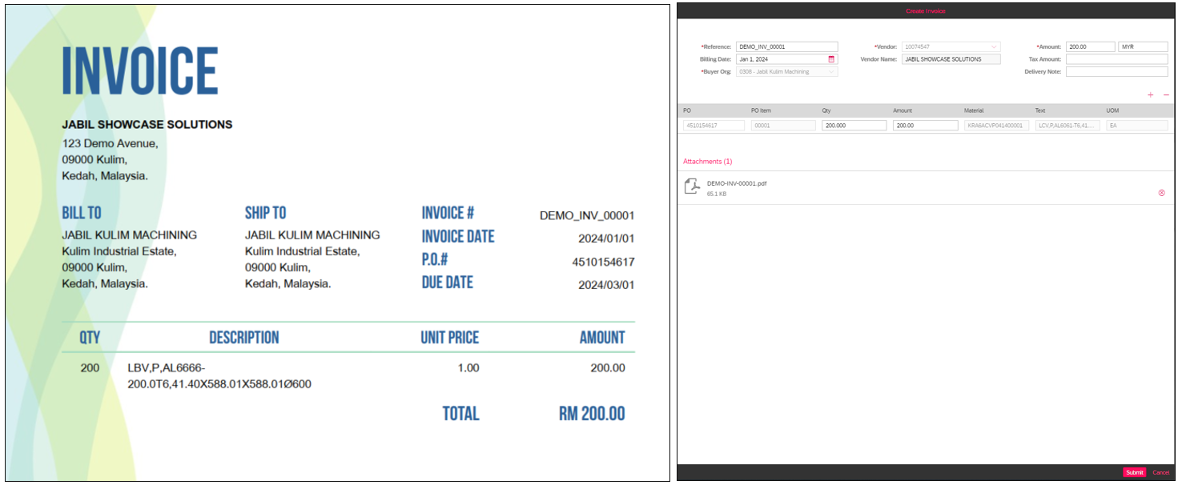
2. Invoice Submission
- “PURCHASE ORDERS” tile
Submit invoice through Purchase Orders tile - Invoice without Tax
1
6
2
#
3
4
5
* Mandatory to attach invoice attachment
1
2
3
Item | Field
1 | Invoice Number
2 | Invoice Date
3 | Purchase Order
4 | Quantity Billed
5 | Line-item Amount
6 | Invoice Total Amount ** Note: For Credit Note, please add negative sign (-) before the invoice amount
# | Delivery Note (only when applicable)
4
5
6

Slide 6
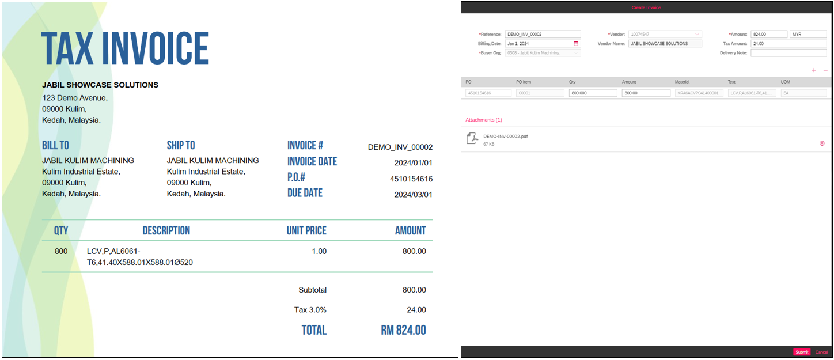
2. Invoice Submission
- “PURCHASE ORDERS” tile
Submit invoice through Purchase Orders tile - Invoice with Tax
1
7
2
#
6
3
4
5
* Mandatory to attach invoice attachment
1
2
3
Item | Field
1 | Invoice Number
2 | Invoice Date
3 | Purchase Order
4 | Quantity Billed
5 | Line-item Amount
6 | Tax Amount
7 | Invoice Total Amount ** Note: For Credit Note, please add negative sign (-) before the invoice amount
# | Delivery Note (only when applicable)
4
5
6
7

Slide 7
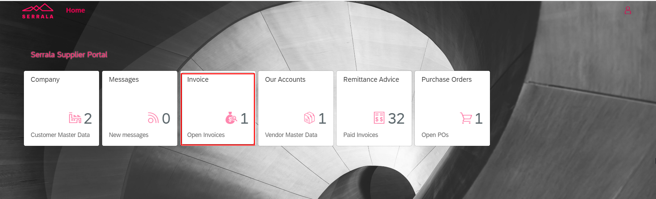
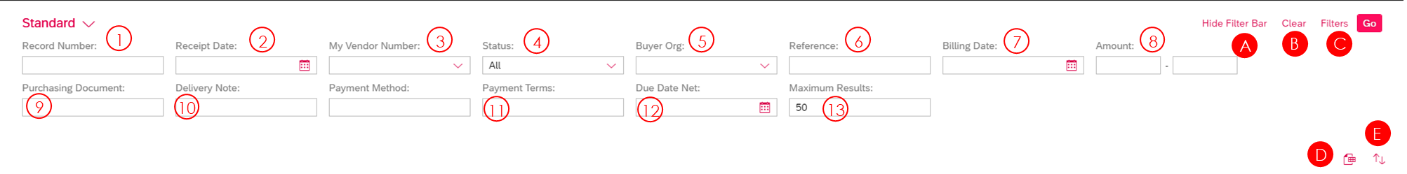
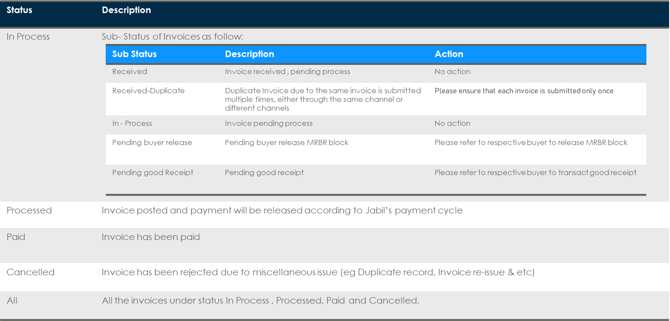
3. Invoice Status Checking
- “INVOICE” tile
Details of status displayed in “Invoice” tile​
Information & useful buttons in “Invoice” tile​
Information
Record Number: The PTS record number created in system
Receipt Date: The date when the invoice is submitted
My Vendor Number: Your registered vendor code with Jabil
Status: The status of the invoices. You can select the status you wish to view from the drop-down list. (i.e. In Process, Processed, Paid, Cancelled and ALL)
Buyer Org: Jabil entity which supplier dealing with
Reference: Invoice reference
Billing Date: Invoice date
Amount: Invoice amount
Purchasing Document: Purchasing Document (PO) number
Delivery Note: Reference of delivery note
Payment Terms: Supplier payment term maintained in Jabil System
Due Date Net: Due date of the invoice
Maximum Results: The number of record shown. Please input “9999”
Useful buttons
A. Hide Filter Bar: Filter bar will be hidden if this is selected
B. Clear: Clear all the filters
C. Filters: More options for Filters is available here
D. Export to Excel: Click here to export the information to Excel file
E. Sort: Sort your invoices in desired order

Slide 8
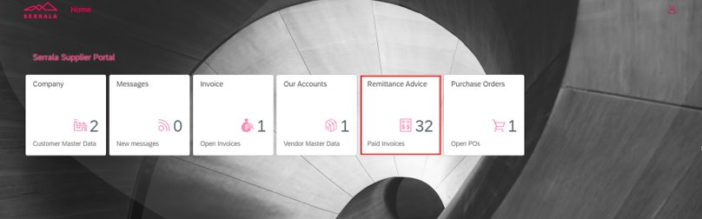
4. Payment Remittance Advice
- “REMITTANCE ADVICE” tile
This tile also shows suppliers’ invoice status.
Similar function with “Invoice” tile. The main difference between two tiles is that, for “Paid” invoices, payment document and payment date will be shown in Remittance Advice tile.

Slide 9
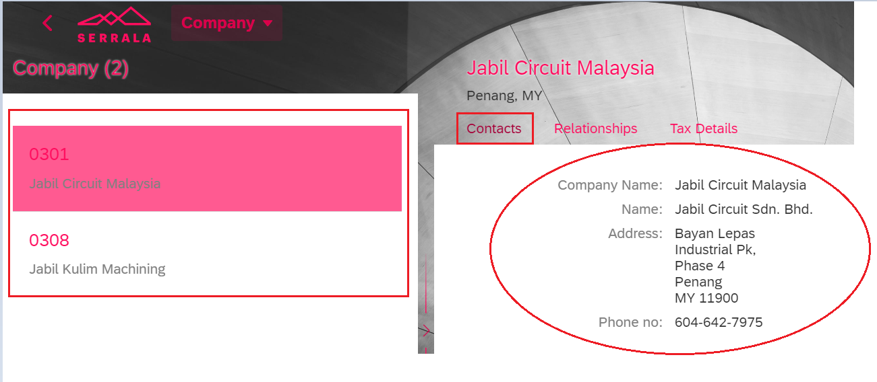
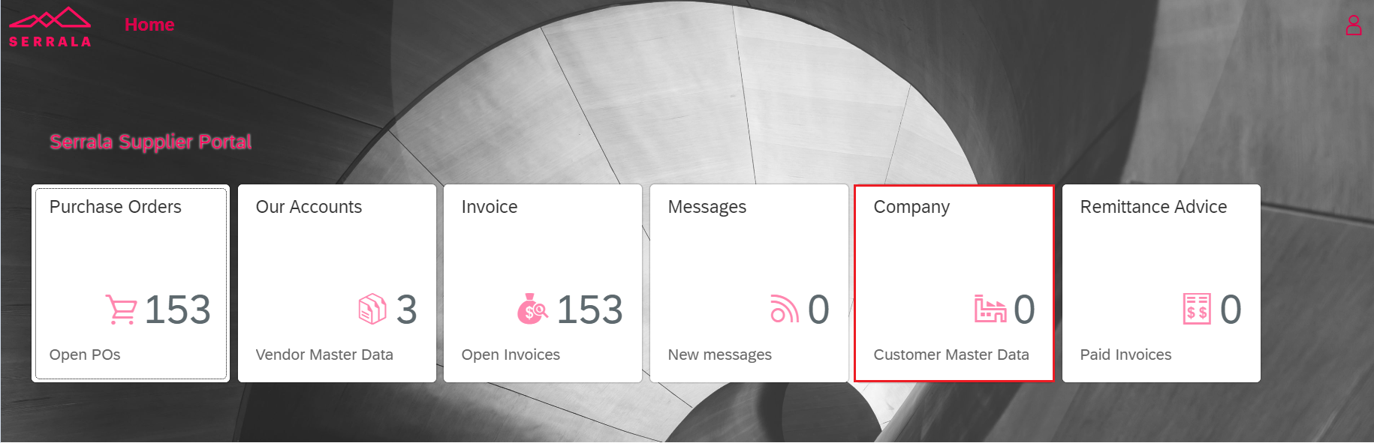
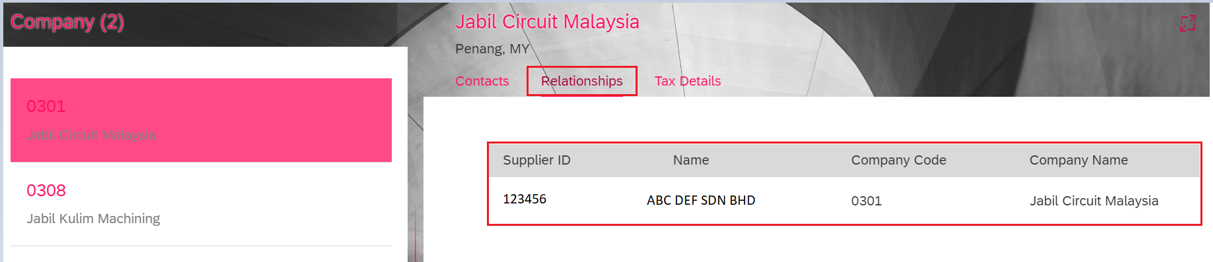
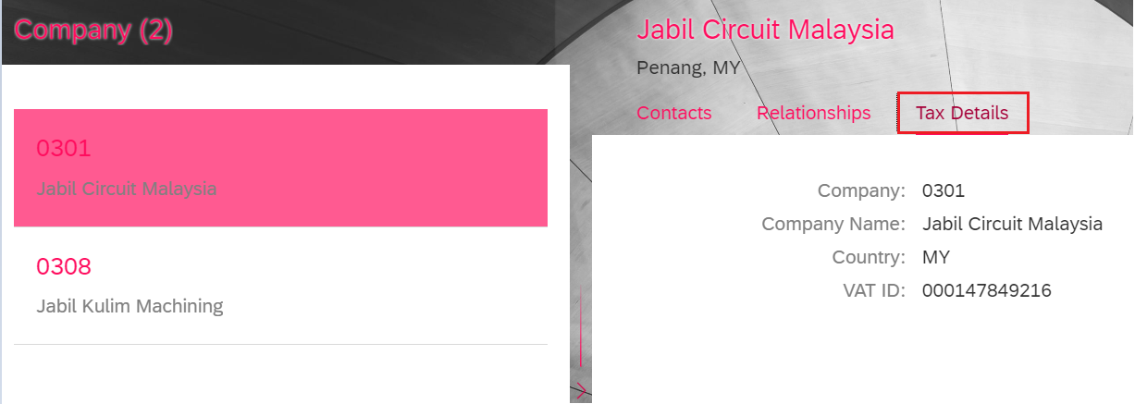
5. Extra Functionalities
- “COMPANY” tile
Contacts
It shows information related to Jabil entity such as Jabil company name and address.
This tile summarizes Jabil company/ entity which supplier is dealing business with, and the related data associated with Jabil company / entity.
If supplier only dealing with 1 Jabil entity, it will show 1 under this tile; Whereas, if supplier is dealing with multiple Jabil entities, it will show the total number of Jabil entity account.
It helps supplier to determine Jabil account information for invoice billing purpose in the case that supplier is having business with multiple Jabil entities.
Relationships
It indicates the relationship between supplier & Jabil entity including Supplier code & name maintained in Jabil system and Jabil entity company code & company name.
Tax Details
It shows Jabil entity’s company code, company name, country origin & tax ID.

Slide 10
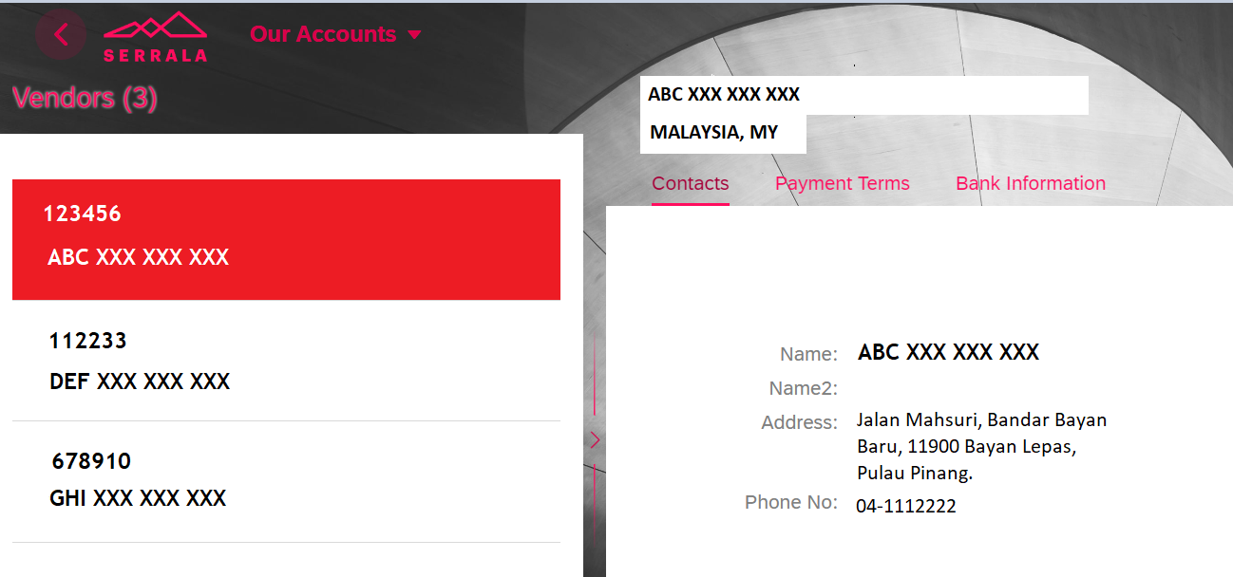
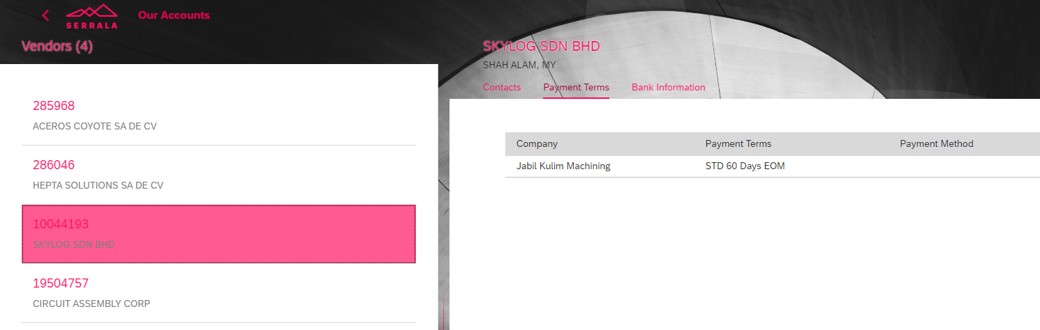
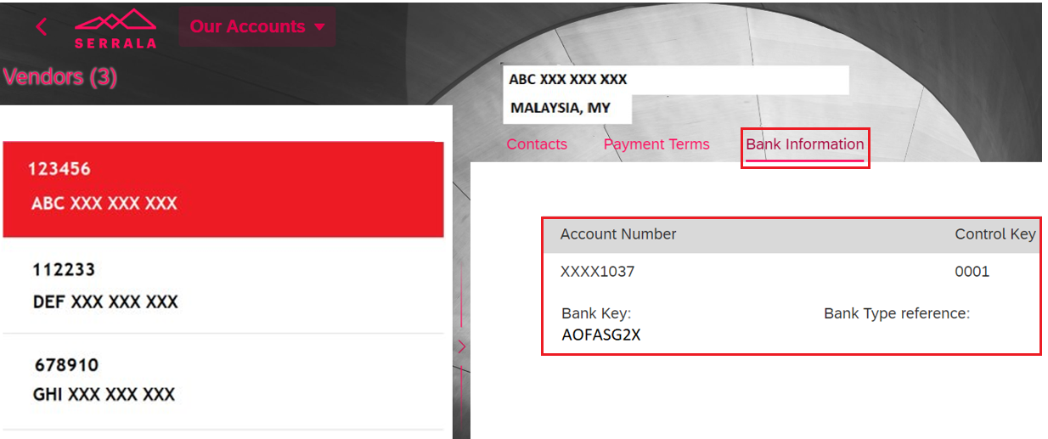
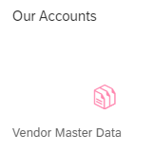
5. Extra Functionalities
- “OUR ACCOUNTS” tile
Contacts
Payment Terms
Bank Information
(1) Vendor Name
(2) Country of Origin
(3) Address
(4) Contact Number
(1) Company – The related Jabil entity which supplier account is dealing with
(2) Payment Terms – Supplier payment term maintained in Jabil System
(1) Bank Account Number (only last 4 digits)
(2) Bank Key
(3) Control Key
This tile summarizes supplier account number with Jabil and all the related data associated with supplier accounts.
It will show 1 account if supplier only has 1 vendor code created with Jabil & vice versa.
Supplier can validate vendor account information. If there is any data discrepancy, please follow current practice to contact respective buyer to update VMM data in order reflect the correct information in Vendor Portal.

Slide 11
APPENDIX

Slide 12
Invoice Submission
Invoice Submission
Category | Direct Material (SAP)
 | Description
Jabil FS2 Vendor Portal | All Direct Material Supplier (Purchase order other than C-10000xxxxxx) are required to submit invoices through Jabil FS2 Vendor Portal. Indirect Materials invoice processing will be remained in Coupa Service Portal (CSP).
 | Please ensure you complete Vendor Portal registration through the email invitation link. If you do not receive any invitation link, please log a ticket through Jabil FS2 Vendor Portal - Queries Form
 | Only submit invoice in PDF Digital / OFD format (OFD format is applicable to E-fapiao); (Not allow ZIP / RAR File / Security Password Folder)
 | Invoice# should not more than 16 digits
 | Strictly for invoice submission only. Avoid send in consignment invoices & Trash (non-invoice documents, packing list, T&C, AP query, SOA, Delivery Note, Acknowledgement)

Slide 13
Invoice Requirements
Invoicing Requirements
Category | Direct Material (SAP)
 | Description
Invoice Date | Invoice shall not be issued prior to the actual date of delivery
Quantity & Unit Price | Quantity and unit price of the itemized goods/services specified in an invoice must be aligned with the purchase order
Purchase Order Number | Mandatory to issue one invoice with one purchase order
 | Mixture of Direct Material and Indirect Material (C-1000XXXXXXXX) purchase orders in the same invoice is not acceptable
 | Mixture of non-consignment order and consignment order in the same invoice is not acceptable

Slide 14
Invoice Requirements
Invoicing Requirements
Category | Direct Material (SAP)
 | Description
Invoice Description (Only applicable to China VAT - CNY currency invoices) | Product description should indicate in the invoice, do not leave it blank
 | Rebate invoice/Credit Note must indicate the rebate reason, original purchase order number with line and original invoice number at “Remarks” column
 | Goods or Taxable Services column must include Chinese description
 | Invoice shall contain the correspondence purchase order number/consignment’s information, vendor code, name of purchaser at “Remarks” column
 | Fixed Asset invoice is required to indicate “Advance payment/Progressive payment/Acceptance payment/Retention payment at “Remarks” column

