Slide 1
Jabil Production Parts Approval Process Introduction
Risk Office | Regulatory Compliance Team
George Zhou

Slide 2
Contents
General Introduction of PPAP
General Jabil PPAP Requirements
Jabil PPAP Templates
Reference Documents

Slide 3
General Introduction of PPAP
What is PPAP?
PPAP: Production Part Approval Process
Standard used to reduce risks prior to product or service release, in a team-oriented manner using well established tools and techniques.
Initially developed by AIAG (Auto Industry Action Group) in 1993 with input from the Big 3 - Ford, Chrysler, and GM .
AIAG’s 4th edition effective June 1, 2006 is the most recent version.
PPAP has now spread to many different industries beyond automotive.
JPPAP: Jabil Production Part Approval Process. It’s a process that Jabil uses to qualify the purchasing parts / components from supplier.

Slide 4
General Introduction of PPAP
Purpose of PPAP
Provide evidence that all customer engineering design record and specification requirements are properly understood by the organization.
To demonstrate that the manufacturing process has the potential to produce product that consistently meets all requirements during an actual production run at the quoted production rate.
PPAP manages change and ensures product conformance!

Slide 5
General Introduction of PPAP
Benefits of PPAP Submissions
Helps to maintain design integrity.
Identifies issues early for resolution.
Reduces warranty charges and prevents cost of poor quality.
Assists with managing supplier changes.
Prevents use of unapproved and nonconforming parts.
Identifies suppliers that need more development.
Improves the overall quality of the product & customer satisfaction.

Slide 6
General Introduction of PPAP
Significant Production Run
The production parts for PPAP shall be taken from a significant production run that:
From 1 hour to 8 hours of production and minimum 300 consecutive parts.
Conducted at the production site.
Conducted at the production rate.
Using the production tooling, gaging and process.
Using the production materials.
Using the production operators.

Slide 7
General Jabil PPAP Requirements
When PPAP is required
Suppliers may be requested to provide a PPAP submission based on the following, but not limited to:
Jabil Customer Requirements.
Jabil Site / Business needs.
Jabil Design needs.
Jabil New Product Introduction needs.
Change in material or sub-supplier.
Production following a location change of manufacturing
Refer to next page for the situations that may trigger a PPAP submission.

Slide 8
General Jabil PPAP Requirements
When PPAP is required
Initial Submission
Engineering Changes to design records
Tooling Transfer, Replacement, Refurbishment
Correction of Discrepancy
Change to Optional Construction or Material
Sub-supplier or Material Source Change
Change in Part Processing
Tooling Inactive > than 1 year
Parts Produced at Additional Location
Other situations required by Jabil Representative
PPAP is required with any significant change to product or process!

Slide 9
General Jabil PPAP Requirements
PPAP submission levels
Supplier shall submit the PPAP items specified in below table per the PPAP submission level. Default submission level is level 3.
However, Jabil presentative may change to other submission level base on the part and the manufacturing process’s complexity.
Level 1 | Production Warrant and Appearance Approval Report (if applicable) submitted to Jabil
Level 2 | Production Warrant, product samples, and limited supporting data submitted to Jabil
Level 3 | Production Warrant, product samples, and complete supporting data submitted to Jabil
Level 4 | Production Warrant and other requirements as defined by Jabil
Level 5 | Production Warrant, product samples and complete supporting data for review at the supplier's manufacturing location

Slide 10
General Jabil PPAP Requirements
The detailed submission items follow below table.
SUBMISSION LEVEL
Requirement |  | Level 1 | Level 2 | Level 3 | Level 4 | Level 5
1. | Design Record | R | S | S | * | R
2. | Engineering Change Documents, if any | R | S | S | * | R
3. | Customer Engineering Approval, if required | R | R | S | * | R
4. | Design FMEA | R | R | S | * | R
5. | Process Flow Diagrams | R | R | S | * | R
6. | Process FMEA | R | R | S | * | R
7. | Control Plan | R | R | S | * | R
8. | Gage Repeatability and Reproducibility Report | R | R | S | * | R
9. | Dimension Results-FAIR | R | S | S | * | R
10. | Material, Performance Test Results | R | S | S | * | R
11. | Initial Process Studies-Cpk | R | R | S | * | R
12. | Qualified Laboratory Documentation | R | S | S | * | R
13. | Appearance Approval Report (AAR), if applicable | S | S | S | * | R
14. | Sample Product | R | S | S | * | R
15. | Master Sample | R | R | R | * | R
16. | Checking Aids-Gauge List | R | R | R | * | R
17. | Record of Compliance With Customer-Specific Requirements, if applicable | R | R | S | * | R
18. | Part Submission Warrant (PSW) | S | S | S | S | R
S = The supplier shall submit designated product approval activity and retain a copy of records or documentation items at appropriate locations including manufacturing.
R = Supplier shall retain at appropriate locations, including manufacturing, and make readily available to Jabil representative upon request.
* = If applicable or required.

Slide 11
General Jabil PPAP Requirements
PPAP submission method
Supplier should submit PPAP to Jabil through Jabil’s E-JPPAP system, unless customer requires to use other methods.
Jabil users need to apply the access to E-JPPAP system. Then Jabil users can create PPAP request and review the PPAP submit by supplier in this system.
Suppliers don’t need account and password to the E-JPPAP system. They will receive the E-JPPAP system notification e-mail when a PPAP case is assigned to them. Supplier will access the PPAP case via the case’s link in the notification e-mail to submit the PPAP. Each single PPAP case has a unique case link.

Slide 12
General Jabil PPAP Requirements
PPAP Review
After supplier submit the PPAP to Jabil, Jabil representatives will review the PPAP. There will be 2 kinds of review result:
Approved: The PPAP documents and samples meet Jabil requirements.
Rejected: The PPAP documents and samples don’t meet Jabil requirements. The PPAP will be returned to supplier. Supplier must take actions for the discrepancies and re-submit the PPAP to Jabil. These steps may be iterated until the PPAP be approved by Jabil.

Slide 13
JPPAP Templates
Overview
Jabil PPAP templates should be used when supplier submit PPAP to Jabil. Unless:
Jabil’s customer requests to use their template. In this case, customer requirements will take precedence.
Jabil did not create the template for the elements. Supplier should use their own format and insert the file to Jabil template. Include: Design Record, Authorized Engineering Change Documents，Customer Engineering Approval，Process Flow Diagram(s)，Material, Performance Test Results，Qualified Laboratory Documentation and some Jabil-Specific Requirements.
Jabil allow supplier to use equivalent format per Jabil PPAP procedure. Supplier shall get the acceptance from Jabil representative to use the equivalent format before submit it to Jabil. Include: Design FMEA，Process FMEA，Control Plan，Gage Repeatability and Reproducibility Report，Dimensional Results - FAIR，Initial Process Studies – Cpk.

Slide 14
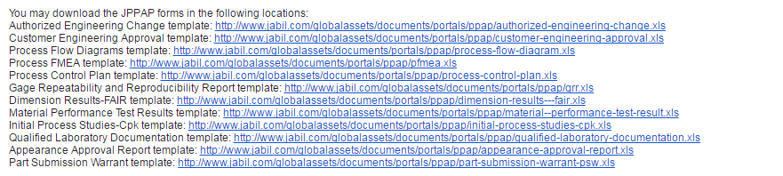
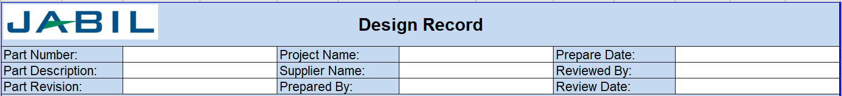
JPPAP Templates
Overview
Supplier can download the Jabil templates by the links in the notification e-mail when PPAP case be assigned to supplier.
Supplier only input in the blank fields in Jabil PPAP templates, do not edit the blue color cells.

Slide 15
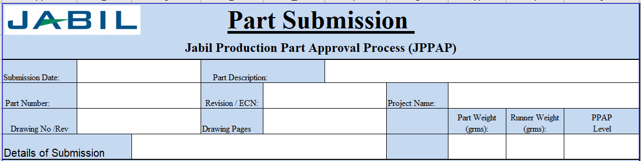
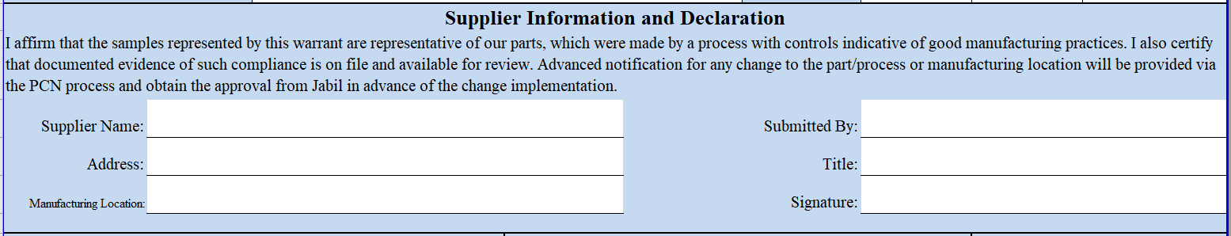
JPPAP Templates
Part Submission Warrant
It requires to use Jabil template unless customer has special requirements.
Supplier input the basic project data and part data in below fields.
Supplier input the supplier & facility data and acknowledge the declaration in below fields.

Slide 16
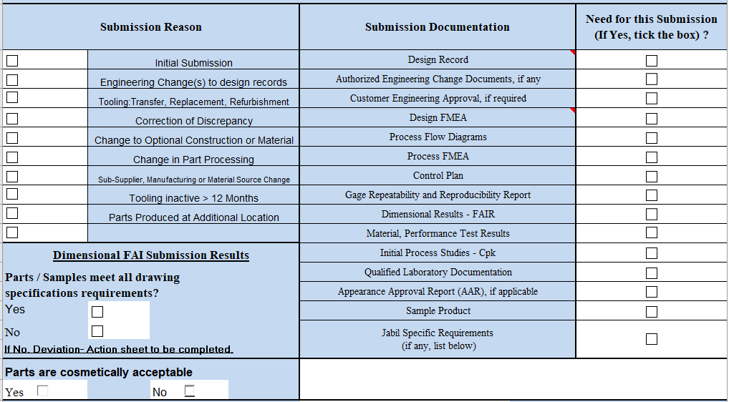
JPPAP Templates
Part Submission Warrant
Supplier tick to select the submission reason, submission documents, claim does parts meet all drawing specifications and cosmetic acceptable or not.

Slide 17
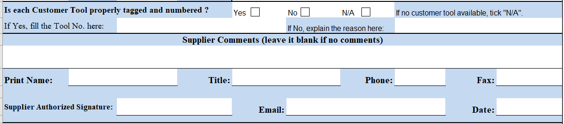
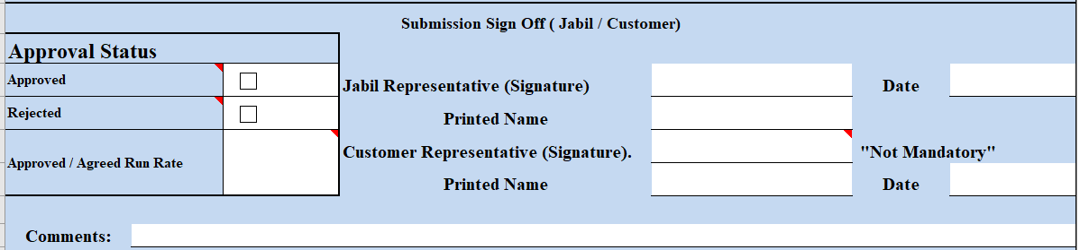
JPPAP Templates
Part Submission Warrant
Supplier claims the customer tool identification status, input the comments and supplier representative sign the PPAP.
Below fields will be filled by Jabil after review the PPAP. Not by supplier.

Slide 18
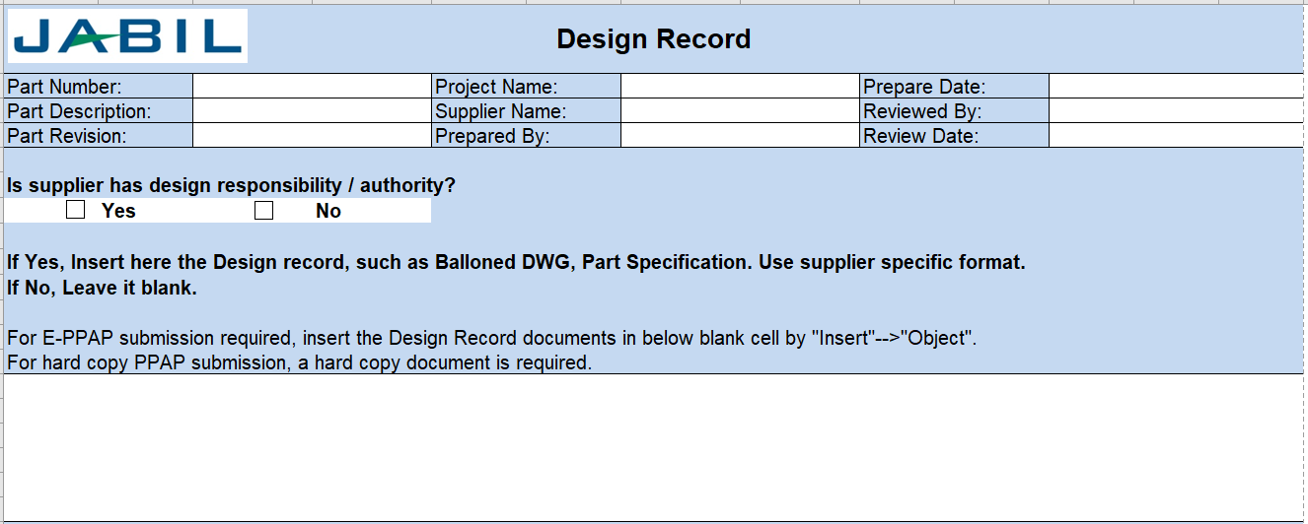
JPPAP Templates
Design Record
It only applies to supplier who has design responsibility / authority.
It includes drawing, specification, etc.
It uses supplier’s format. Supplier should insert it to Jabil’s Design Record template.

Slide 19
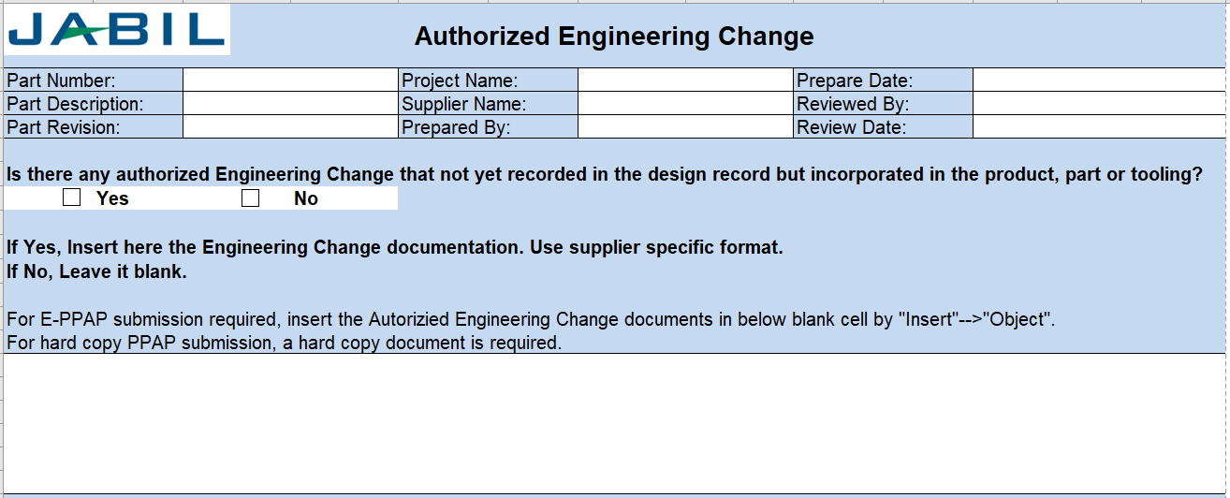
JPPAP Templates
Authorized Engineering Change Documents
supplier shall provide authorized change documents for those changes not yet recorded in the design record, but incorporated in the product, part or tooling, such as: ECNs, Specifications, Supplier change requests, etc.
It uses supplier’s format. Supplier should insert it to Jabil’s Authorized Engineering Change template.

Slide 20
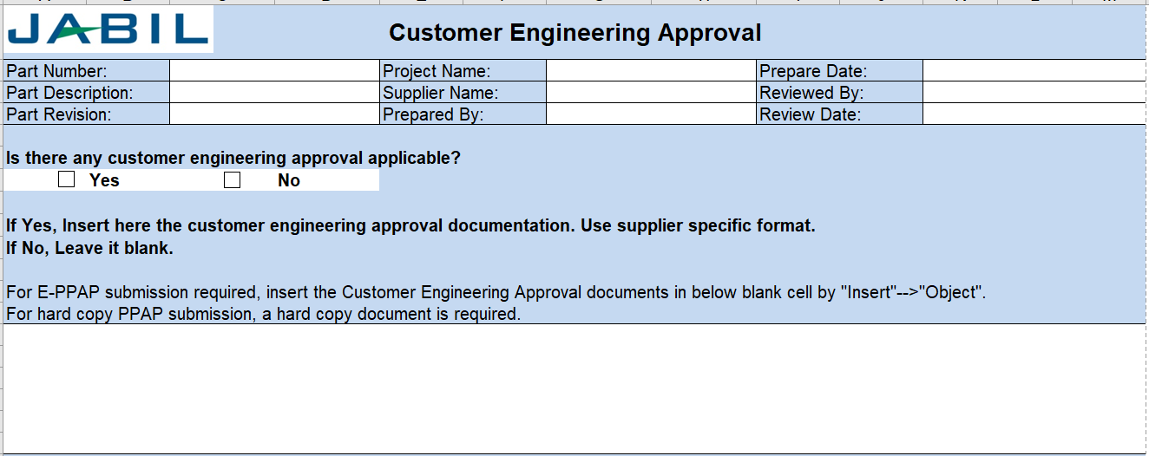
JPPAP Templates
Customer Engineering Approval
Where specified by Customer/Jabil, the supplier shall have evidence of Customer/Jabil engineering Approval, e.g., customer approval for design record or ECN.
It uses supplier’s format. Supplier should insert it to Jabil’s Customer Engineering Approval template.

Slide 21
JPPAP Templates
FMEA
FMEA is a common approach to address:
Potential product or process failure to meet expectations
Potential consequences
Potential causes of the failure mode
Application of current controls
Level of risk / prioritization
Risk reduction

Slide 22
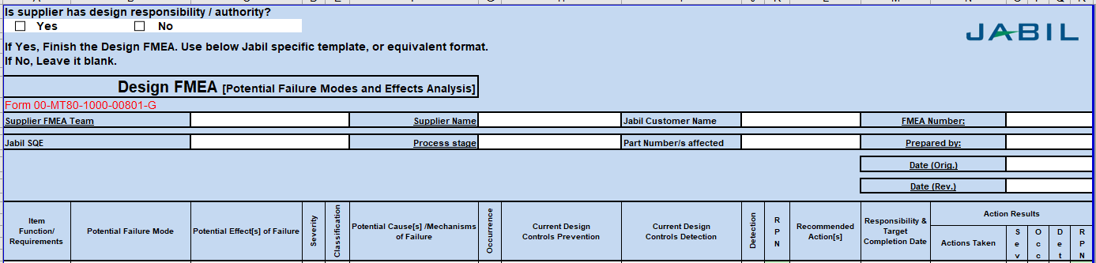
JPPAP Templates
Design FMEA
It only applies to supplier who has design responsibility / authority.
The product design-responsible supplier shall develop a Design FMEA in accordance with, and compliant to, customer requirements.
It must be developed and maintained by a cross-function team.
It uses Jabil’s format, or equivalent format if accepted by Jabil.

Slide 23
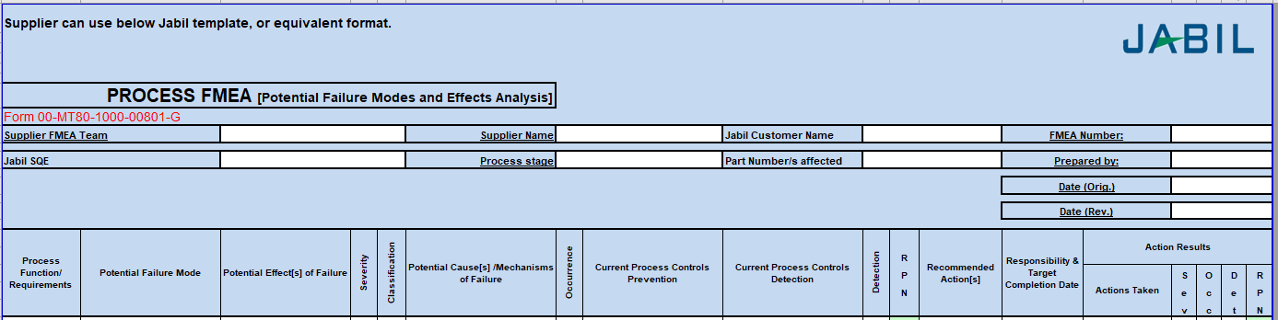
JPPAP Templates
Process FMEA
It applies to all suppliers who have manufacturing process.
The process steps in PFMEA must align to the process flow diagram and the process control plan.
It must be developed and maintained by a cross-function team.
It uses Jabil’s format, or equivalent format if accepted by Jabil.

Slide 24
FMEA - Step 1
General steps to develop FMEA. Take PFMEA as an example.
Failure Modes
For each Process Input,
determine the ways in
which the input can go
wrong.
Using the completed
Process Flow Diagram,
enter the process step.
TIPS
There should be at least one failure mode for each input.

Slide 25
FMEA - Step 2
Potential Failure Effects
For each Failure Mode,
determine what effect
the specific failure
could have on the
process output.
TIPS
There should be at least one failure effect for each failure mode.
Effects should be specific, clear, and leave no doubt to the uninformed reviewer.

Slide 26
FMEA - Step 3
Potential Causes
For each Failure Mode,
determine the possible
cause of the failure.
TIPS
There should be at least one potential cause for each failure mode.

Slide 27
FMEA - Step 4
Current Controls
For each potential
cause, list the current
method used for
preventing or detecting
failure.
TIPS
This step in the FMEA begins to identify initial shortcomings or gaps in the current control plan.
If a procedure exists, enter the document number.
If no current control exists, list as “none.”

Slide 28
FMEA - Step 5
Assign Severity, Occurrence, and Detection ratings
Assign Severity
(How serious is the
effect if it fails?)
Assign Detection
(How easily can the
cause or failure
mode be detected?)
Assign Occurrence
(How likely is the
cause to occur?)
Severity, Occurrence and Detection rating details on next slide

Slide 29
PFMEA - Definition of Terms
Severity (of Effect) - severity of the effect on the Customer and other stakeholders (Higher Value = Higher Severity)
Occurrence (of Cause) - frequency with which a given Cause occurs and creates Failure Mode. (Higher Value = Higher Probability of Occurrence)
Detection (Capability of Current Controls) - ability of current control scheme to detect the cause before creating the failure mode and/or the failure mode before suffering the effect (Higher Value = Lower Ability to Detect)
Caution: Notice the scale difference for Detection!

Slide 30
Example of Rating Definitions
Rating
Severity | Occurrence | Detection*
Hazardous without warning | Very high and almost inevitable | Cannot detect or detection with very low probability
Loss of primary function | High repeated failures | Remote or low chance of detection
Loss of secondary function | Moderate failures | Low detection probability
Minor defect | Occasional failures | Moderate detection probability
No effect | Failure unlikely | Almost certain detection
High 10
Low 1
*If No Controls Exist, Detection = 10
Create a rating system that makes sense for the
defects you are trying to prevent.

Slide 31
PFMEA - Step 6
Calculate the Risk Priority Number
RPN = Severity x Occurrence x Detection
TIPS
The RPN is used to prioritize the most critical risks identified in the first half of the FMEA.
High RPNs are flags to take effort to reduce the calculated risk.
Regardless of RPN, high Severity scores (9 or 10) should be given special attention.

Slide 32
PFMEA – Remediation Guidelines
Severity – can only be improved by a design change to the product
Occurrence – can only be reduced by a change which removes or controls a cause. Examples are redundancy, substituting a more reliable component or function or mistake-proofing.
Detection – can be reduced by improving detection. Examples are mistake-proofing, simplification and statistically sound monitoring.
In general, reducing the Occurrence
is preferable to improving the Detection

Slide 33
FMEA – Step 7
Determine Actions Recommended to reduce High RPNs
For the high RPN numbers,
determine the
recommended actions.

Slide 34
FMEA – Steps 8 and 9
Resp (responsibility)
Assign a specific person
who will be responsible
for recommended actions.
Actions Taken
As actions are identified
and completed, document
in the “Actions Taken”
column.
SEV, OCC, DET, RPN
As actions are complete
reassess Severity,
Occurrence, and Detection
and recalculate RPN.
Now recalculate your RPNs
based on mitigation plans.
TIPS:
Continue updating the actions taken and
resulting RPNs until all risks are at an acceptable level.

Slide 35
Summary Steps To Complete a FMEA
For each Process Input, determine the ways in which the Process Step can go wrong (these are Failure Modes).
For each Failure Mode associated with the inputs, determine Effects on the outputs.
Identify potential Causes of each Failure Mode.
List the Current Controls for each Cause.
Assign Severity, Occurrence and Detection ratings after creating a ratings key appropriate for your project.
Calculate RPN.
Determine Recommended Actions to reduce High RPNs.
Take appropriate Actions and Document.
Recalculate RPNs.
Revisit steps 7 and 8 until all the significant RPNs have been addressed.

Slide 36
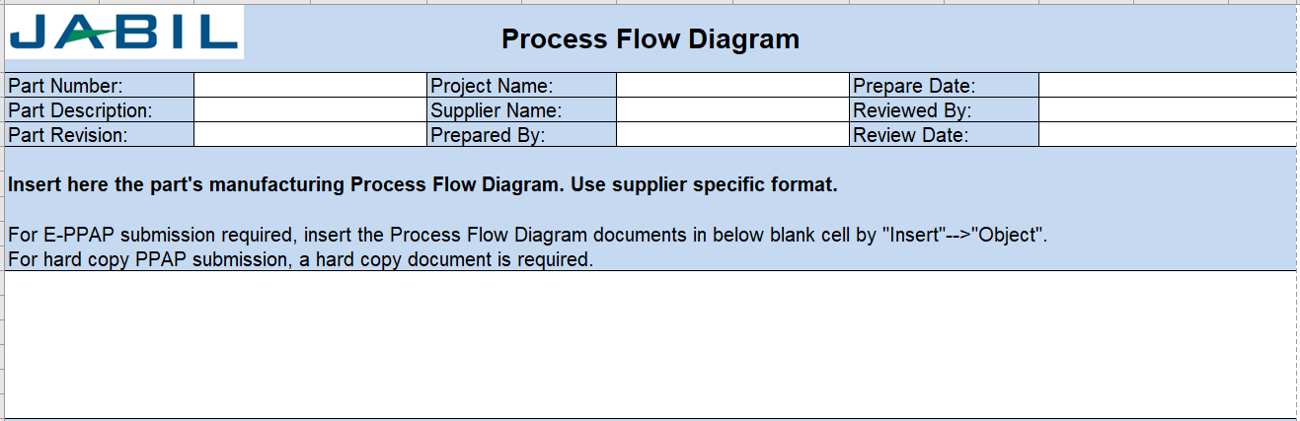
JPPAP Templates
Process Flow Diagram
Supplier shall have a process flow diagram that clearly describe the production process steps and sequence.
The process flow once submitted and accepted cannot be altered without Jabil approval and resubmission of JPPAP.
It uses supplier’s format. Supplier should insert it to Jabil’s Process Flow Diagram template.

Slide 37
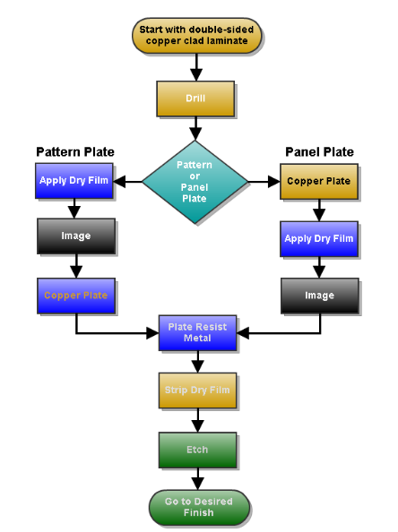
JPPAP Templates
Process Flow Diagram _ example

Slide 38
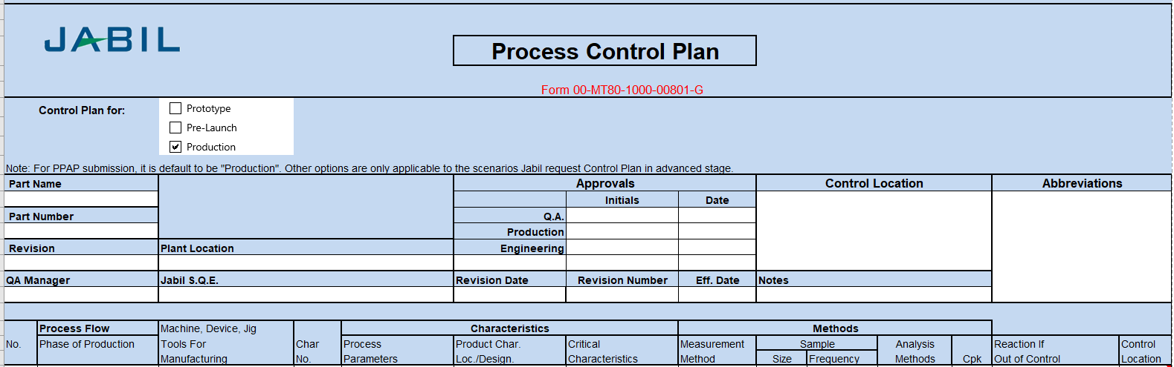
JPPAP Templates
Process Control Plan
Supplier shall have a Control Plan that defines all methods used for process control and complies with customer-specified requirements.
The process flow in control plan must align to the process flow diagram and the process FMEA.
It uses Jabil’s format, or equivalent format if accepted by Jabil.

Slide 39
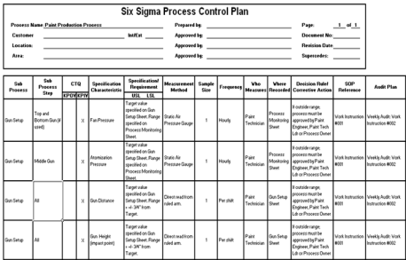
JPPAP Templates
Tool Interaction
Process Steps
New/Revised Process Steps
Process FMEA
Process Flowchart
Risk Prioritized
Process Steps
Process Steps
New/Revised
Process Steps
Improved
Controls
Control Plan

Slide 40
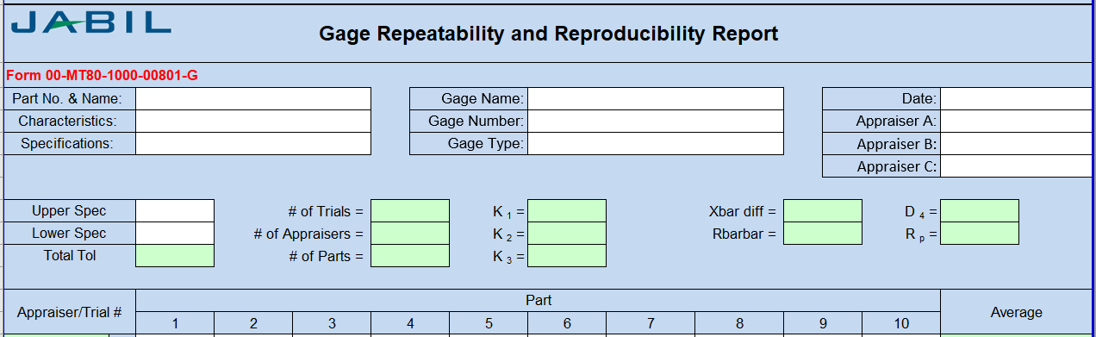
JPPAP Templates
Gauge R&R
To be executed on all critical process control features (to control identified product critical characteristics) identified on engineering documentation, including continued use of data for process characterization.
It uses Jabil’s format, or equivalent format if accepted by Jabil.

Slide 41
JPPAP Templates
Gauge R&R
Gage R&R is the combined estimate of measurement system Repeatability and Reproducibility.
Typically, a 3-person study is performed
  Each person randomly measures 10 marked parts per trial
  Each person can perform up to 3 trials
There are 3 key indicators
  EV or Equipment Variation
  AV or Appraiser Variation
  Overall % GRR
  Number of Distinct Categories (NDC)

Slide 42
JPPAP Templates
Step 1
Step 2
Step 3
Step 4
Step 5
Step 6
Step 7
Step 8
Step 9
Step 10
Select 10 items that represent the full range of long-term process variation.
Identify the appraisers.
If appropriate, calibrate the gage or verify that the last calibration date is valid.
Open the Gage R&R worksheet in the JPPAP template to record data.
Ask each appraiser to assess each part 3 times (trials – first in order, second in reverse order, third random).
Input data into the Gage R&R worksheet.
Enter the number of operators, trials, samples and specification limits
Analyze data in the Gage R&R worksheet.
Assess MSA trust level.
Take actions for improvement if necessary.

Slide 43
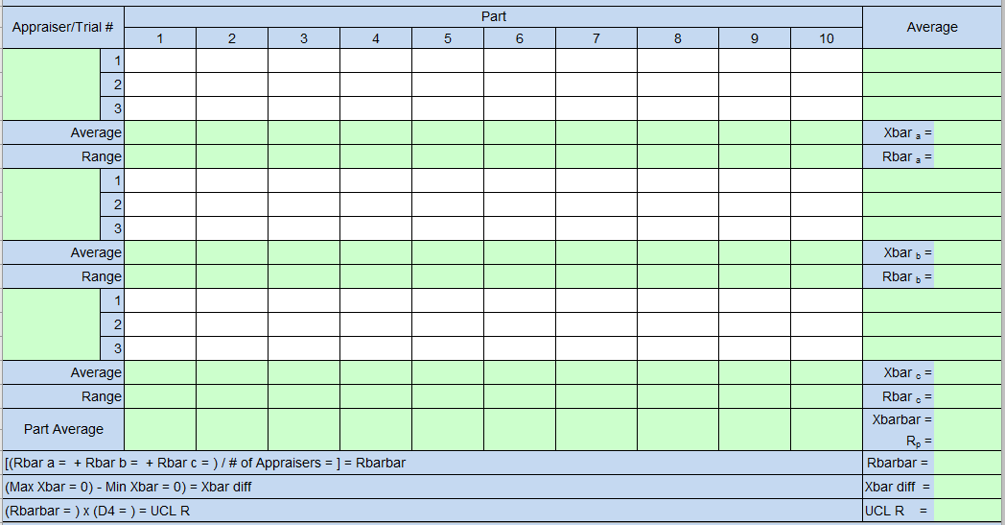
JPPAP Templates
Gauge R&R

Slide 44
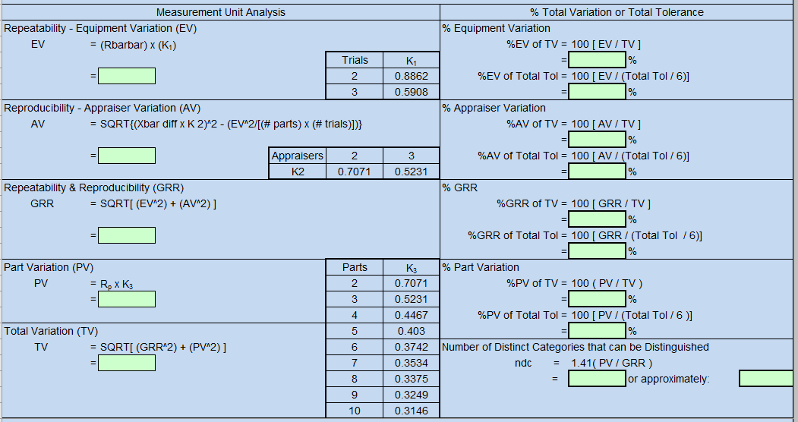
JPPAP Templates
Gauge R&R

Slide 45
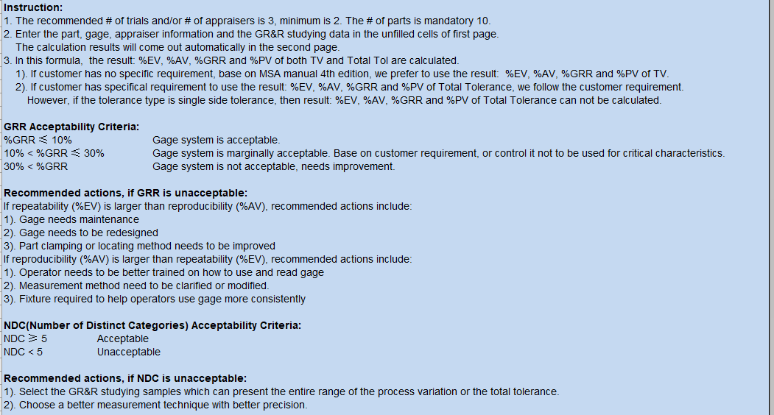
JPPAP Templates
GR&R instruction and result analysis.

Slide 46
JPPAP Templates
Dimensional Results – FAIR
It proves that dimensional verifications have been completed and results indicate compliance with specified requirements.
Supplier shall submit a minimum of three (3) samples of each part or assembly, from each tool and/or cavity.
Samples shall be taken from normal settings or parameters established by the supplier to be used during normal production and shall be produced by means following the referenced production Process Flow Diagram.
If the values identified in this report do not meet the requirements as defined on the piece part print, Supplier must notify Jabil via the “Parts Submission Warrant” block titled: “Submission Results.”
If the parts fail to meet any JPPAP requirements, supplier must address with cause and corrective action for discrepancies via Deviation-Action Template.
It uses Jabil’s format, or equivalent format if accepted by Jabil.

Slide 47
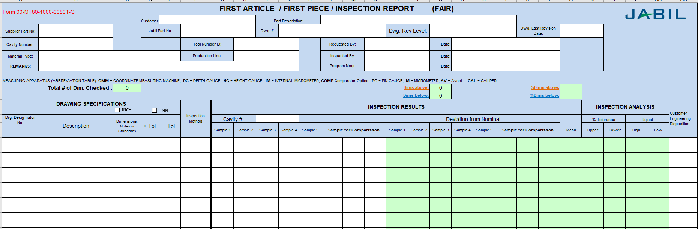
JPPAP Templates
Dimensional Results – FAIR

Slide 48
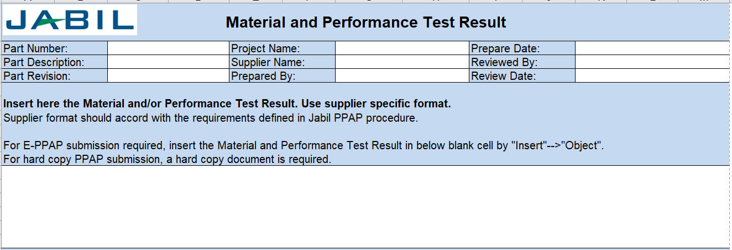
JPPAP Templates
Material, Performance Test Results
Supplier shall have records of material and/or performance test results for tests specified on the design record or Control Plan
It uses supplier’s format. Supplier should insert it to Jabil’s Matl & Perf Test Result template.

Slide 49
Material / Performance Test Results
Material Test Results
The supplier shall perform tests for all parts and product materials when chemical, physical, or metallurgical requirements are specified by the design record or Control Plan
    For products with Jabil-developed material specifications and/or an Jabil-approved supplier list, the supplier shall procure materials and/or services from suppliers on that list
Performance Test Results
The supplier shall perform tests for all parts or product materials when performance or functional requirements are specified by the design record or Control Plan

Slide 50
JPPAP Templates
Initial Process Studies-Cpk
The purpose of the initial process study is to determine if the production process is likely to consistently produce products that meet customer’s requirements.
The initial process studies should cover all special characteristics designated by customer or Jabil.
Supplier shall complete measurement system analysis before the initial process study.
The study should be done on a minimum 30 random pieces that taken from a minimum population of 300 pieces produced in significant production run. If the sample quantity is not enough before PPAP submission, Jabil may require initial process study in mass production.
Minimum acceptable Cpk value is ≥1.67, unless a specific Cpk value is defined by customer or Jabil site/division.
It uses Jabil’s format, or equivalent format if accepted by Jabil.

Slide 51
Steps for Process Capability Studies
Steps of initial Process studies
Step 1
Step 2
Step 3
Step 4
Step 5
Step 6
Step 7
Decide on the product or process characteristic to be assessed
Validate the specification limits
Validate the measurement system
Collect data
Assess data characteristics
Assess process stability
Calculate process capability

Slide 52
Capability Indices
Cpk predicts capability
  Based on short term within subgroup variation
  Does not include the effect of process variability between subgroups
Cpk should be used when:
  Developing new parts
  Revising specifications on a part
  Materials, processes, manufacturing location, or equipment have significantly changed
  Material suppliers have changed (include certificate of analysis)

Slide 53
Difference between Cp & Cpk
Cp – determines capability of producing to specification
Cpk – same as Cp, but also measures how centered the process is
It is important to look at both!
>
Cp
1.67
Cpk
>
Cpk
1.67
<
1.00
Capable, Centered
Capable, Not Centered
LSL
USL
LSL
USL
<
<
Cp
Cpk
1.00
1.00
Not Capable, Centered
Not Capable, Not Centered
LSL
USL
LSL
USL

Slide 54
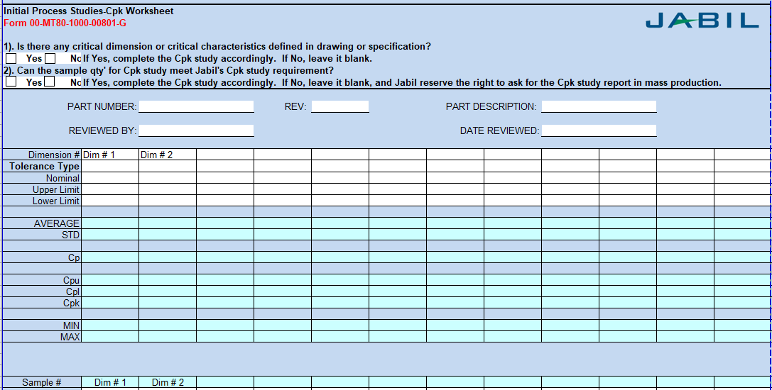
JPPAP Templates
Initial Process Studies-Cpk

Slide 55
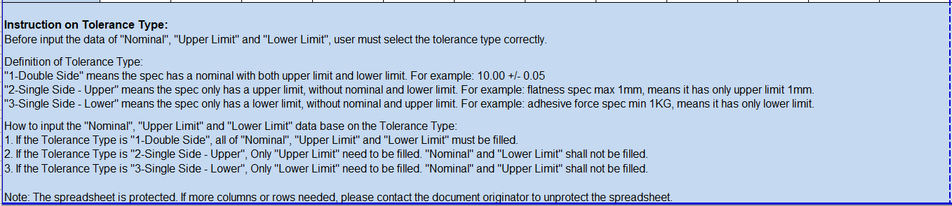
JPPAP Templates
Instruction on how to select the tolerance type.
Initial Process Studies-Cpk

Slide 56
JPPAP Templates
Qualified Laboratory Documentation
Inspection and testing for PPAP shall be performed by a qualified laboratory as defined by customer (e.g., an accredited laboratory).
The qualified laboratory shall have a laboratory scope and documentation showing that the laboratory is qualified for the type of measurements or tests conducted.
When an external/commercial laboratory is used, supplier shall submit the test results on the laboratory letterhead or the normal laboratory report format.
It uses supplier’s format. Supplier should insert it to Jabil’s Qualified Laboratory Document template.

Slide 57
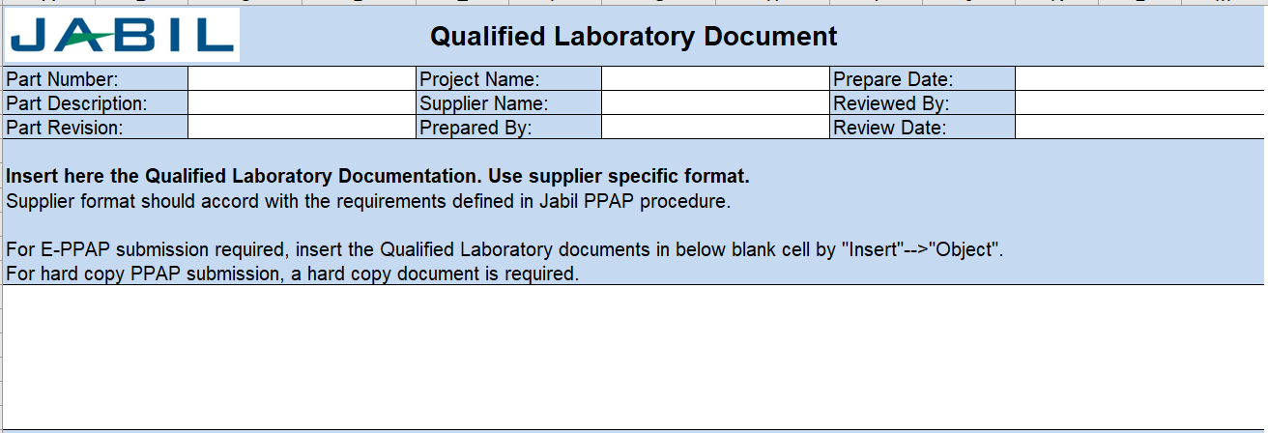
JPPAP Templates
Qualified Laboratory Documentation

Slide 58
JPPAP Templates
Appearance Approval Report _ AAR
A separate AAR shall be completed for each part or series of parts if the product/part has appearance requirements on the design record. Typically for parts with color, grain, or surface appearance requirements.
Samples should be submitted to Jabil Design Engineering or Site SQE or other designated appropriate Jabil personnel for approval.
Signed copies of the approval document(s) along with the sample(s) signed for which the document represents, shall be maintained on file at each of the supplier’s sites which manufacture the part.
For guidance on the application of cosmetic standards, customer standards take priority. If no customer standards exist, reference Jabil Workmanship Standards For Systems Integration,00-QS60-1000-003.
It uses Jabil’s AAR format.

Slide 59
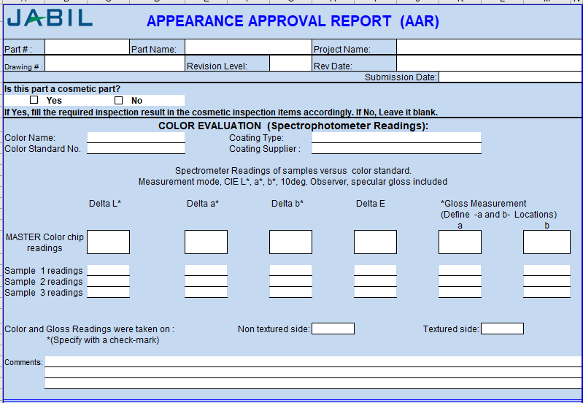
JPPAP Templates
Appearance Approval Report _ AAR

Slide 60
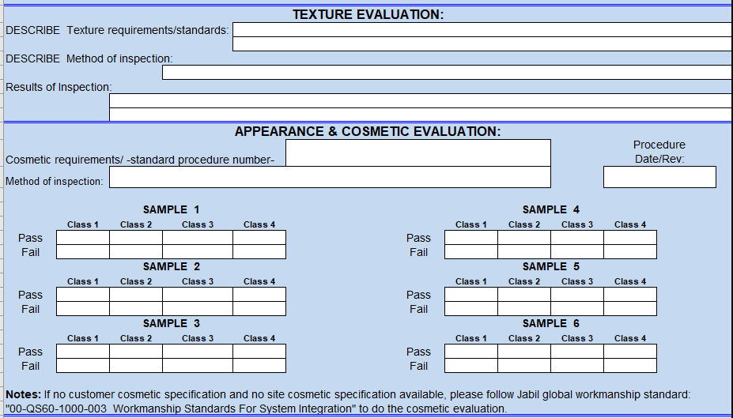
JPPAP Templates
Appearance Approval Report _ AAR

Slide 61
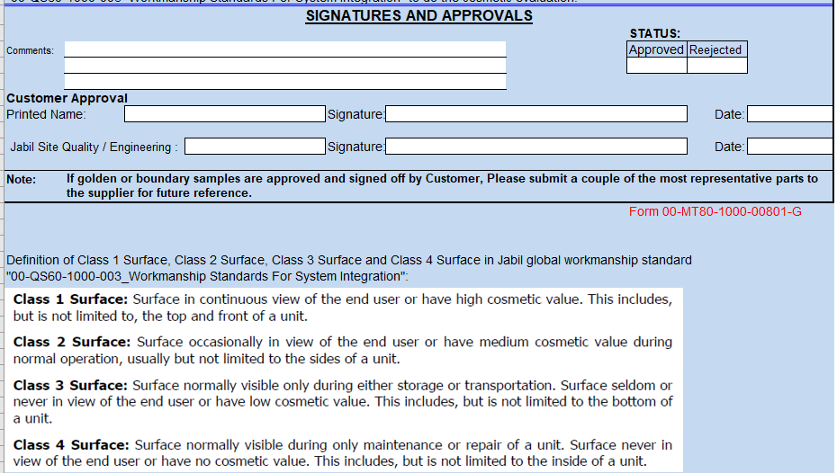
JPPAP Templates
Appearance Approval Report _ AAR

Slide 62
JPPAP Templates
Jabil Specific Requirements
Jabil PPAP owner can define the Jabil Specific Requirements in E-JPPAP system.
Supplier shall submit all applicable Jabil specific requirements which required by Jabil.
Feasibility Report, Attribute GR&R and Training Matrix utilize the Jabil template or equivalent format.
Other specific required documents use supplier specific format. Supplier need to insert them into the Jabil Specific Requirements template.

Slide 63
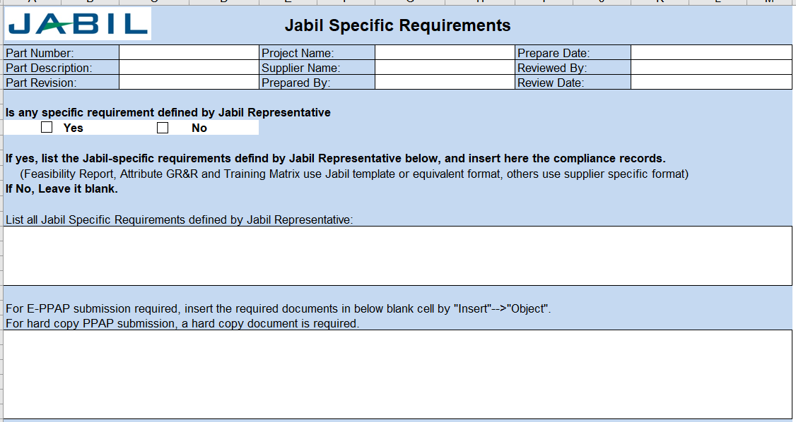
JPPAP Templates
Jabil Specific Requirements

Slide 64
JPPAP Templates
Sample Products
Supplier shall submit the samples to Jabil according to the requirements from Jabil representative.
The samples may include:
FAI samples. If the samples will be used for measurement comparison purpose, supplier must identify each sample’s serial number that aligns to the serial number in FAI report.
Appearance Approval samples.
Master samples.
Supplier shall provide the samples’ tracking information in E-JPPAP system.

Slide 65
Reference Documents
Reference Documents:
RO-RG20-00011_Jabil Production Part Approval Process
00-MT80-1000-00801_JPPAP Templates

Slide 66
Thank You

